Slide 1
Evolution with Hosts
Jason Andrews
Jeremy Goldhaber-Fiebert
May 21, 2020

Slide 2
Announcements

Slide 3
If mutations lead to a lower equilibrium fitness, why have mutations?
Do faster mutation rates navigate better to fitness maxima?

Slide 4
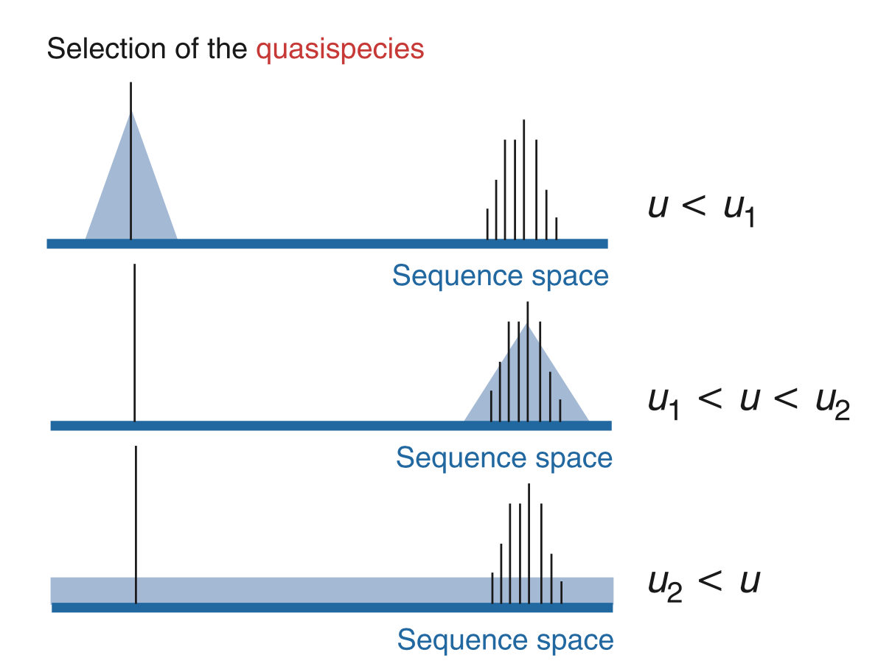

Slide 5
Summary of fitness and adaptation
Selection occurs when organisms have different rates of reproduction
When growth is exponential, selection leads to survival of the fittest
Mutations enable co-existence of strains with different fitness
Quasispecies are populations of genetically related organisms, formed by mutation and selection
There is typically one stable equilibrium of quasispecies, it is often not the fittest but rather a distribution around the fittest
Adaptation cannot occur if mutation rates are too high

Slide 6
Evolution of virulence

Slide 7
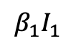
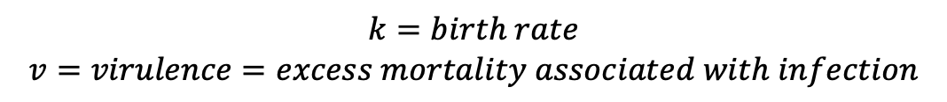
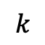

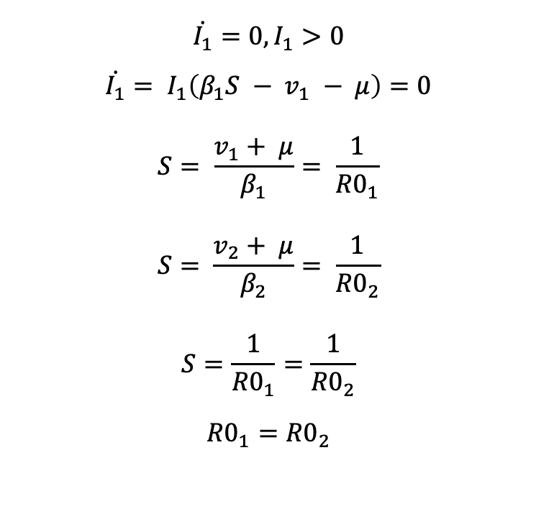
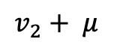
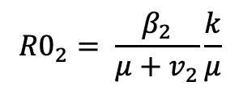
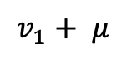

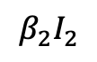
Selection when competing for hosts
$$β_{1}I_{1}$$
I₁
Question: Assuming R0₁ > 1 and R₀₂ > 1, can there be an endemic equilibrium for I₁ and I₂?
$$v_{1}+ μ$$
$$k$$
S
$$\dot{I_{1}}=0, I_{1}>0$$
$${\dot{I_{1}}= I}_{1}\left(β_{1}S − v_{1} − μ\right)=0$$
$$S= \frac{v_{1}+ μ}{β_{1}}= \frac{1}{{R0}_{1}}$$
$$S= \frac{v_{2}+ μ}{β_{2}}= \frac{1}{{R0}_{2}}$$
$$S=\frac{1}{{R0}_{1}}=\frac{1}{{R0}_{2}}$$
$${R0}_{1}={R0}_{2}$$
$$β_{2}I_{2}$$
$$v_{2}+ μ$$
I₂
$$\dot{S}=k −S\left(β_{1}I_{1}+β_{2}I_{2}\right)− μS$$
$$\dot{I_{1}}=I_{1}\left(β_{1}S − v_{1} − μ\right)$$
$$\dot{I_{2}}=I_{2}(β_{1}S −v_{2}− μ)$$
$$k=birth rate$$
$$v=virulence=excess mortality associated with infection$$
$${R0}_{1}= \frac{β_{1}}{μ+v_{1}}\frac{k}{μ}$$
$${R0}_{2}= \frac{β_{2}}{μ+v_{2}}\frac{k}{μ}$$
The only way to have coexistence of two species in full competition for hosts is for equal R_{0.}

Slide 8
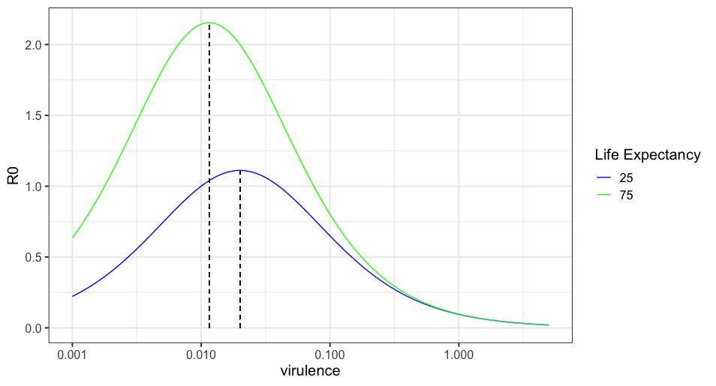
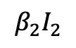
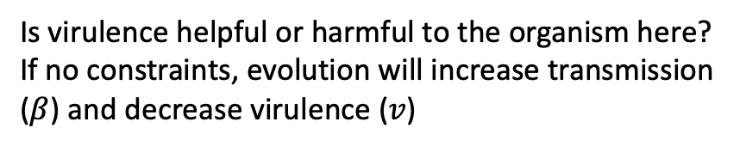
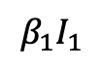
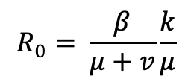
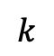
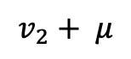
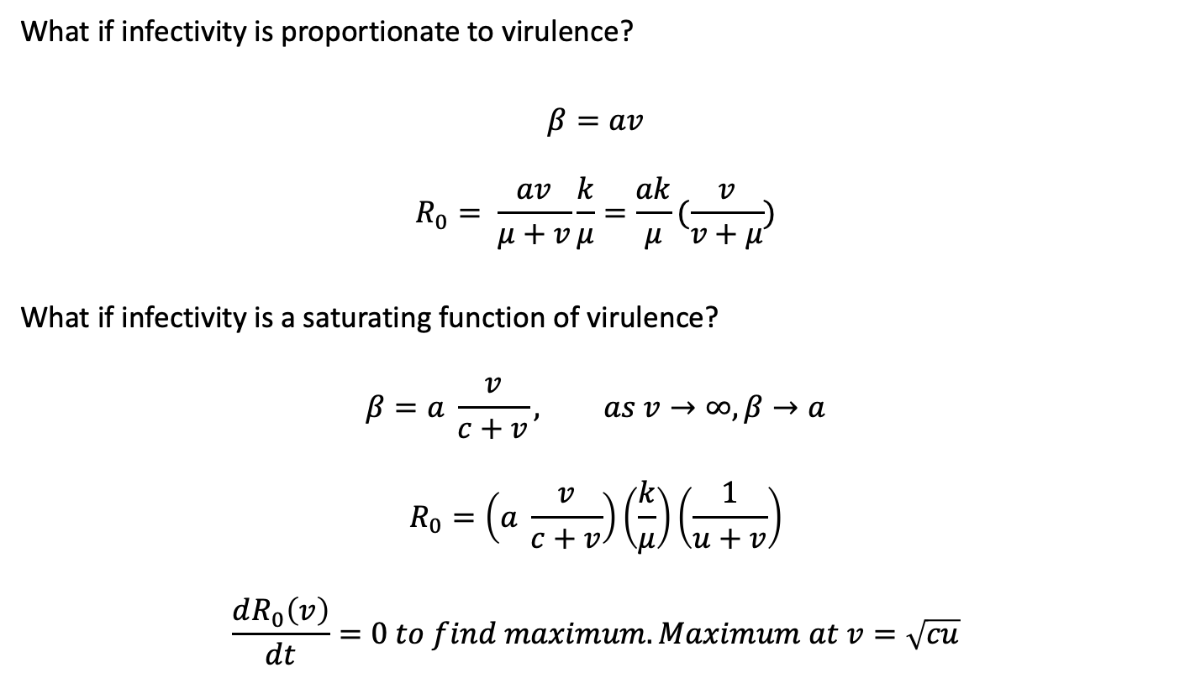
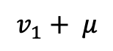
Evolution maximizes R₀
$$β_{1}I_{1}$$
I₁
$$v_{1}+ μ$$
$$R_{0}= \frac{β}{μ+v}\frac{k}{μ}$$
$$k$$
Is virulence helpful or harmful to the organism here?
If no constraints, evolution will increase transmission ($β$) and decrease virulence ($v$)
S
$$β_{2}I_{2}$$
$$v_{2}+ μ$$
I₂
What if infectivity is proportionate to virulence?
$$β=av$$
$$R_{0}= \frac{av}{μ+v}\frac{k}{μ}=\frac{ak}{μ}(\frac{v}{v+μ})$$
What if infectivity is a saturating function of virulence?
$$β=a \frac{v}{c+v}, as v→∞, β→a$$
$$R_{0}=\left(a \frac{v}{c+v}\right)\left(\frac{k}{μ}\right)\left(\frac{1}{u+v}\right)$$
$$\frac{dR_{0}\left(v\right)}{dt}=0 to find maximum. Maximum at v=\sqrt{cu}$$

Slide 9
Virulence Summary
When there is competition for hosts, evolution generally maximizes R₀
If virulence and infectivity scale linearly, organisms would increase virulence to their maximum
Usually there are constraints in relationship between virulence and infectivity, such that organisms will evolve towards intermediate virulence to maximize R₀

Slide 10
Superinfection
When a new strain is able to infect a host who is already infected
Leads to:
Higher virulence than optimal for maximizing R0
Co-existence of strains with range of virulence
Fewer infected hosts than without superinfection

Slide 11

Further Reading
Nowak, Evolutionary Dynamics, Chapter 11
Otto and Day, A Biologists Guide to Mathematical Modeling in Ecology and Evolution, Chapter 12

Slide 12
Antimicrobial Resistance

Slide 13
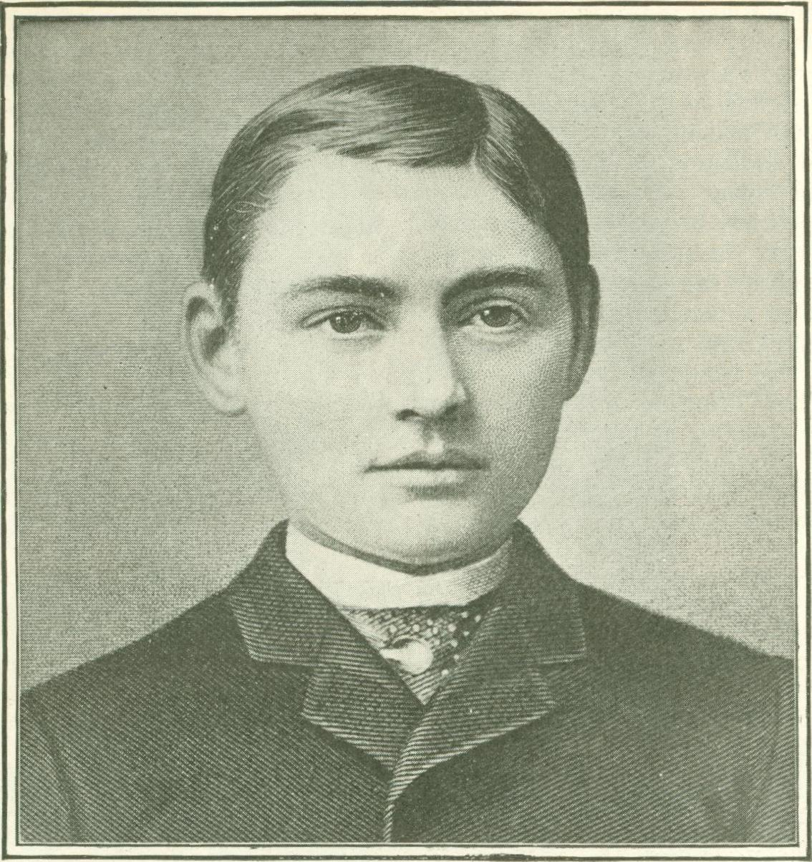
Leland Stanford, Jr.
(1868 – 1884)

Slide 14
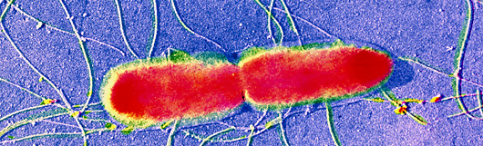
Typhoid Fever (“enteric fever”)
Bacterial infection caused by Salmonella Typhi
Transmitted by fecal-oral route, person-to-person or via contaminated food or water
10-25 million cases annually, vast majority in low or middle income countries
Untreated, case fatality rate is 15-25%

Slide 15
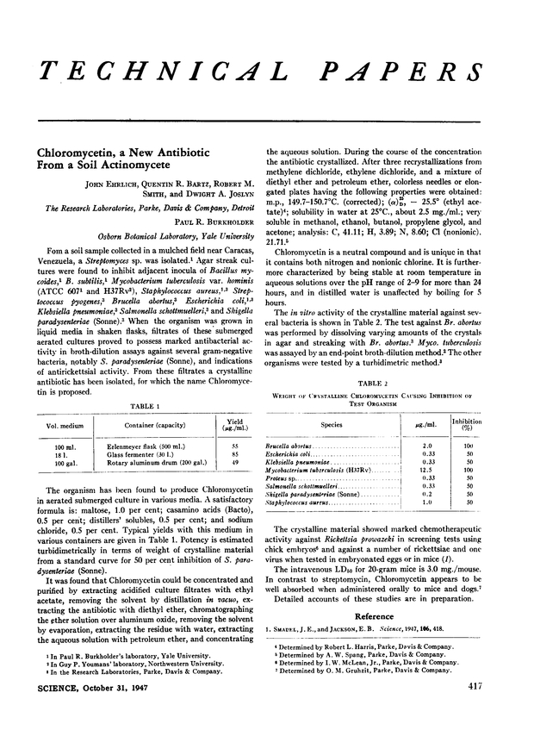


Slide 17
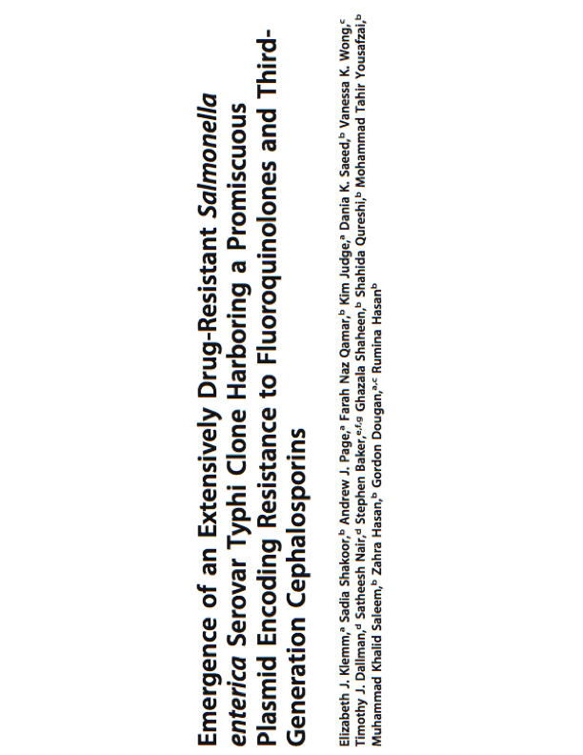

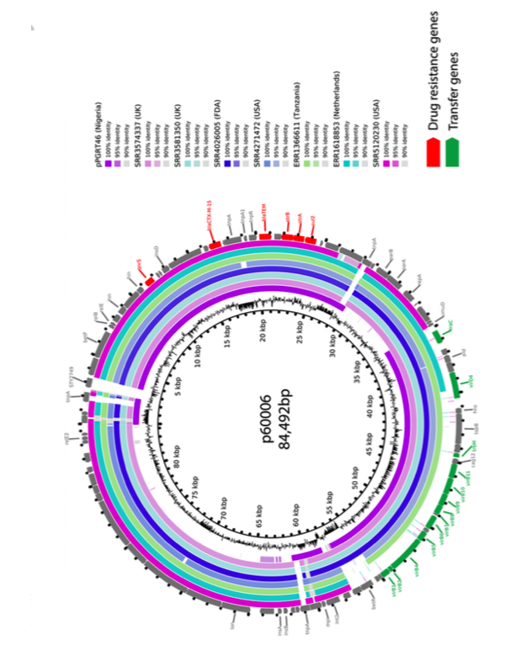

Slide 18



Slide 19
Will AMR bacteria win the arms race?
What favors their selection? What constrains their spread?

Slide 20
Antimicrobial Resistance Exercise
Create a SI model for antimicrobial resistant organisms competing with susceptible organisms. Draw the model, write out the differential equations. Assume that having antimicrobial resistance might alter the fitness of the organism in various ways.
What factors determine whether the resistant organism outcompetes the susceptible one?

Slide 21
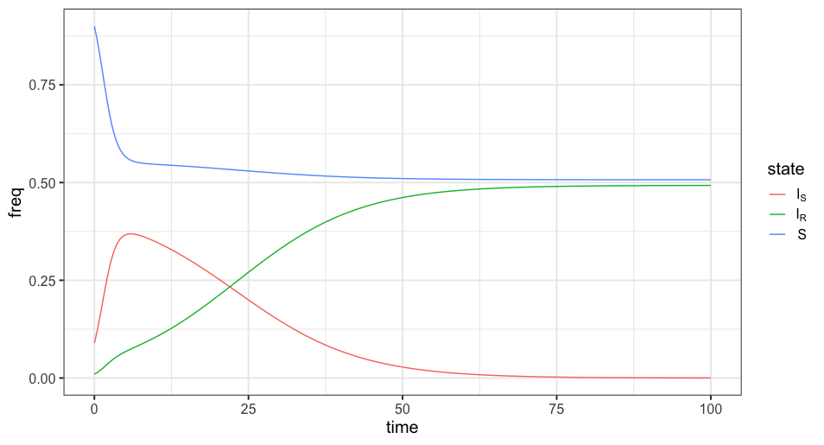
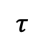
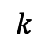
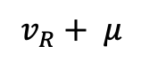
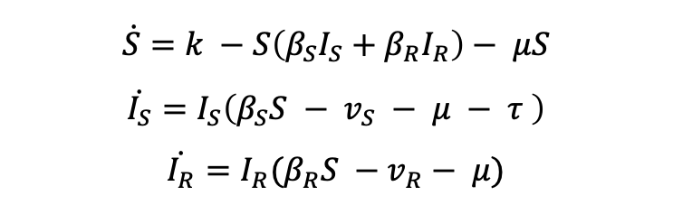
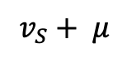
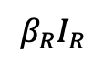
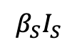
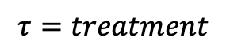
A Model for Antimicrobial Resistance
$$\dot{S}=k −S\left(β_{S}I_{S}+β_{R}I_{R}\right)− μS$$
$$\dot{I_{S}}=I_{S}\left(β_{S}S − v_{S} − μ − τ \right)$$
$$\dot{I_{R}}=I_{R}(β_{R}S −v_{R}− μ)$$
$$v_{S}+ μ$$
$$β_{S}I_{S}$$
I_{s}
$$k$$
$$τ$$
S
$$τ=treatment$$
$$β_{R}I_{R}$$
I_{R}
$$v_{R}+ μ$$
Lipsitch, Trends in Micro, 2001

Slide 22
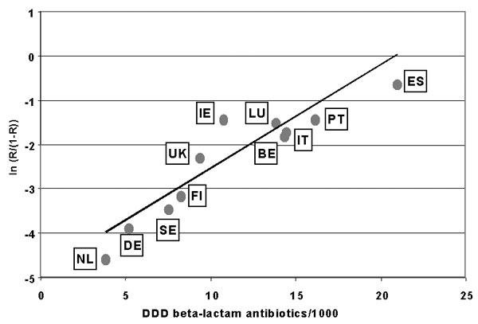
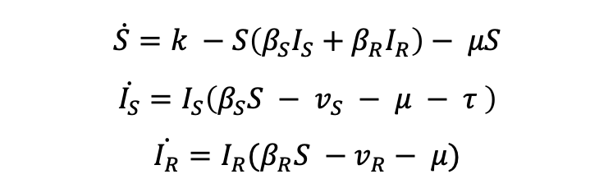
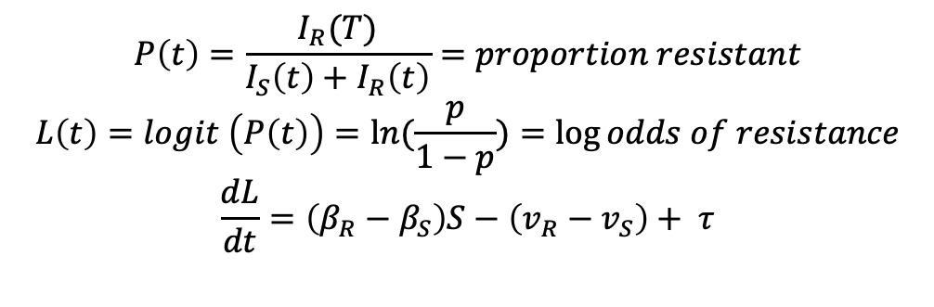
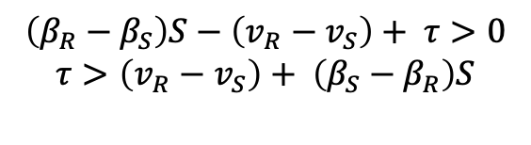
AMR Model Insights
$$\dot{S}=k −S\left(β_{S}I_{S}+β_{R}I_{R}\right)− μS$$
$$\dot{I_{S}}=I_{S}\left(β_{S}S − v_{S} − μ − τ \right)$$
$$\dot{I_{R}}=I_{R}(β_{R}S −v_{R}− μ)$$
$$P\left(t\right)=\frac{I_{R}(T)}{I_{S}\left(t\right)+I_{R}\left(t\right)}=proportion resistant$$
$$L\left(t\right)=logit \left(P\left(t\right)\right)=\ln{(\frac{p}{1−p})}=\log{odds of resistance}$$
$$\frac{dL}{dt}=\left(β_{R}−β_{S}\right)S−\left(v_{R}−v_{S}\right)+ τ$$
Bronzwaer et al, EID 2002
$$\left(β_{R}−β_{S}\right)S−\left(v_{R}−v_{S}\right)+ τ>0$$
$$τ>\left(v_{R}−v_{S}\right)+ \left(β_{S}−β_{R}\right)S$$
Implications:
Log odds of resistance rises linearly with antibiotic use
Resistant organisms can be less transmissible and more virulent and still spread, in presence of antibiotics
More virulent
Less Transmissible

Slide 23
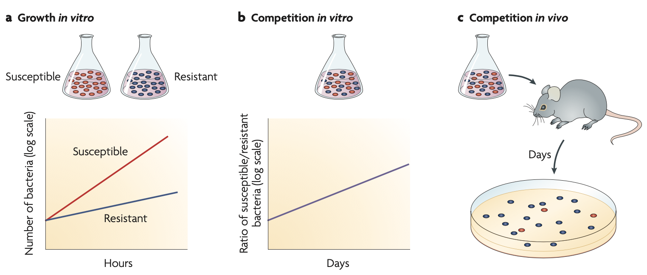
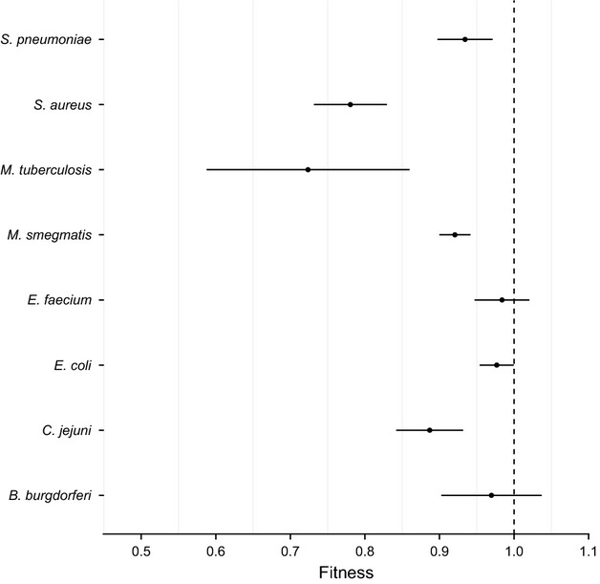
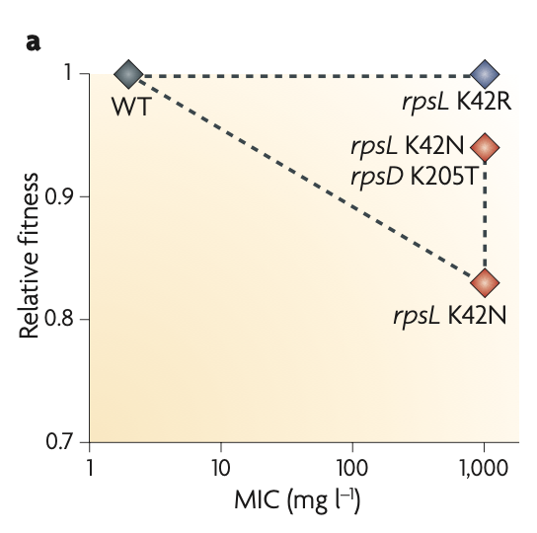
AMR and fitness
Andersson and Hughes, Nat Micro 2010
Melnyk et al, Evol Appl, 2015

Slide 24
Exploiting fitness deficits for therapy
In medicine, we sometimes intentionally give an antimicrobial to which an organism is resistant, in order to maintain that variant that is less fit, and then treat with a second antimicrobial to kill that population of organisms
Examples:
M184V mutation in HIV confers resistance to lamivudine, but decrease replication fitness by 4-8%, increases reverse transcriptase fidelity, decreasing further spontaneous mutagenesis, and increases susceptibility to other ARVs.
MRSA with VanA-type resistance to Vancomycin have 20-38% reduction in fitness, but only in the presence of Vancomycin.

Slide 25

Cycling and Steering

Slide 26
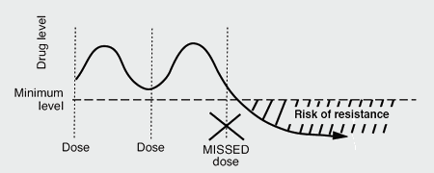
Are more antibiotics bad or good for AMR?
“Always complete the full prescription, even if you feel better, because stopping treatment early promotes the growth of drug-resistant bacteria” – World Health Organization, 2016
Inadequate treatment
“Hit hard and hit fast”
-Paul Ehrlich, 1913

Slide 27
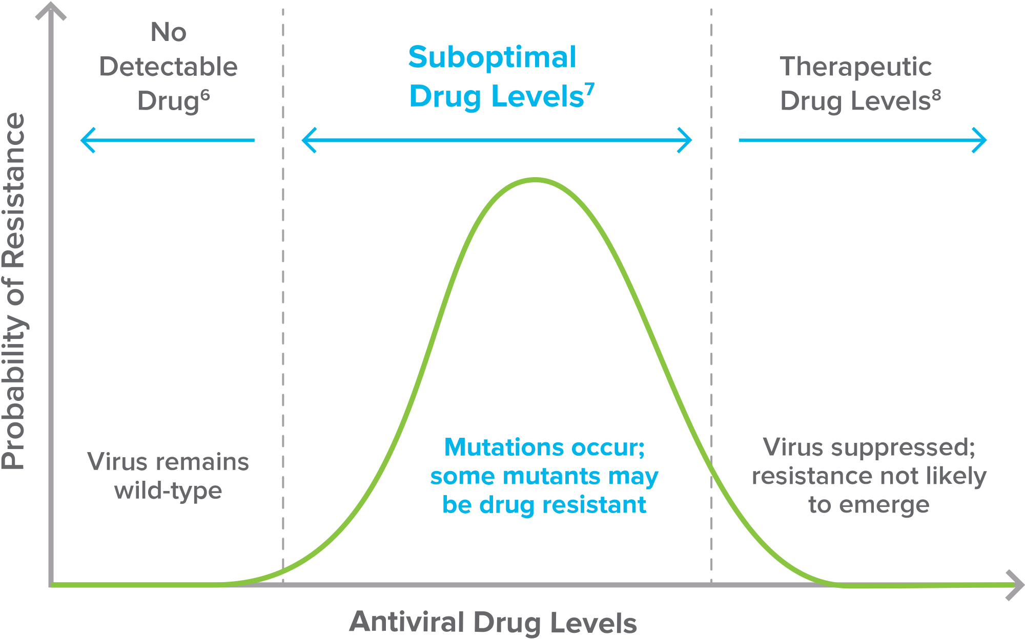
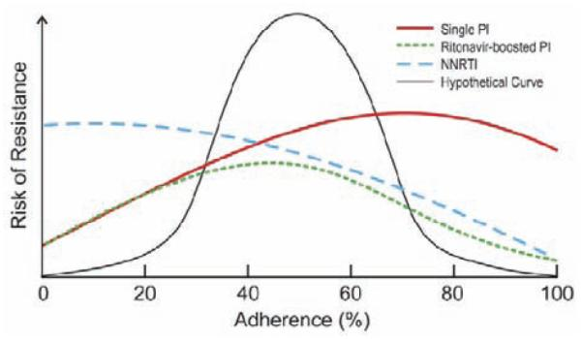
Antimicrobial and AMR relationship complex at individual level
Nachega et al, Infect Disord Drug Targets 2011

Slide 28
Antibiotics in the environment
>70% of antibiotics used are used in livestock
Pathways
Highly resistant bacteria observed in animals, may directly infect humans
Runoff of antibiotics into environment creating selective pressure in environmental bacteria or when ingested by humans

Slide 29
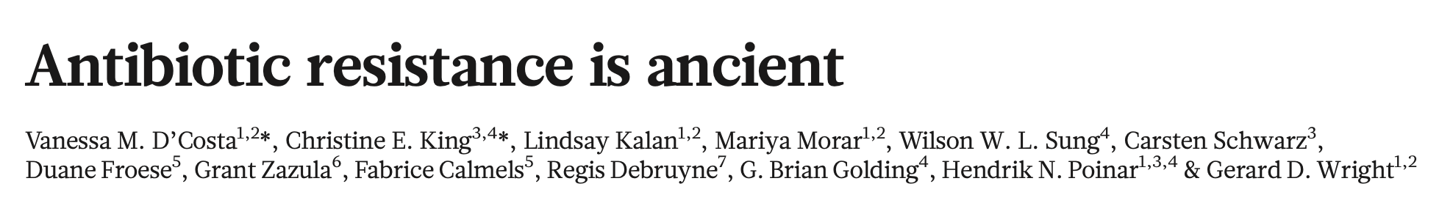

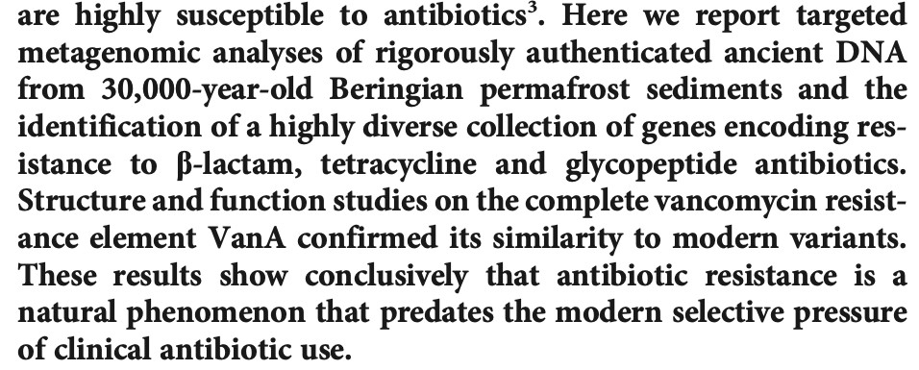

Slide 30
Summary of AMR Dynamics
Antibiotic use creates selective pressure for emergence of resistance
Within the individual, the risk of AMR emergence is complex and might be optimized at intermediate use of antimicrobials
At population level, greater use of antimicrobials selects for AMR strains by reducing the presence of susceptible strains
AMR acquisition often comes at an initial fitness cost to organisms, though sometimes organisms can further evolve to compensate (at least partially) for fitness
The amount of fitness deficit possible (decreased transmissibility, increased virulence) depends on the antimicrobial pressure
Antimicrobial exposures from environment, human-made or natural, may be important drivers of AMR

Slide 31
Further Readings of Models of AMR

Slide 32
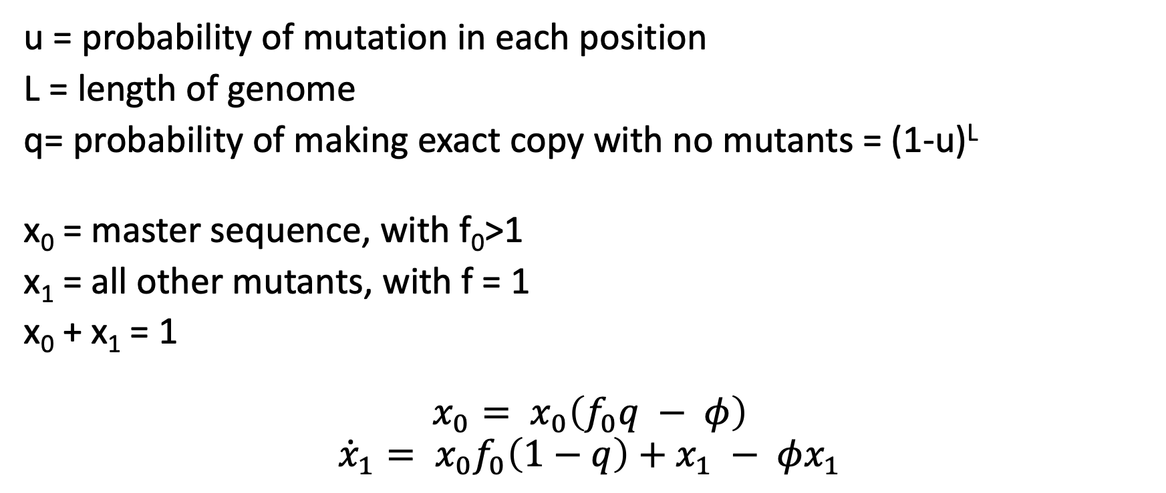
Mutations across the genome
x(t=0)= 1011
x(t=1)= 1011
u = probability of mutation in each position
L = length of genome
q= probability of making exact copy with no mutants = (1-u)^{L}
x₀ = master sequence, with f₀>1
x₁ = all other mutants, with f = 1
x₀ + x₁ = 1
$$x_{0}= x_{0}\left(f_{0}q − φ\right)$$
$${\dot{x}}_{1}= x_{0}f_{0}\left(1−q\right)+x_{1} − φx_{1}$$

Slide 33
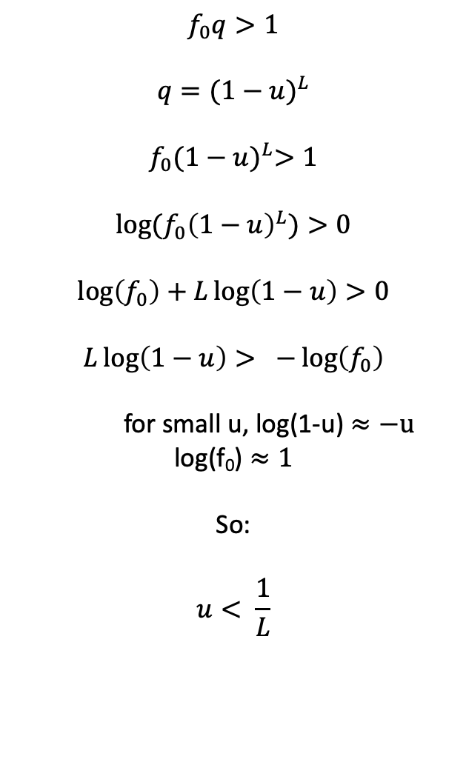
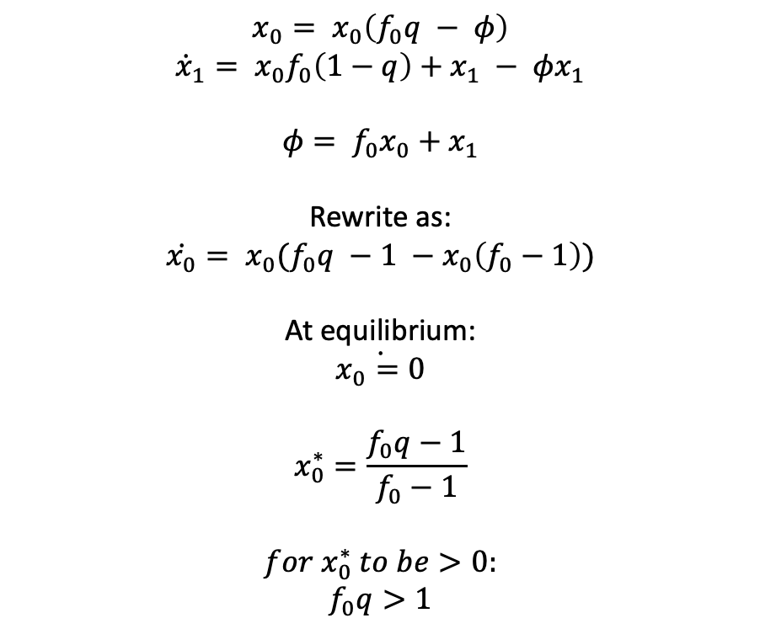
Constraints on mutation rates
$$f_{0}q>1$$
$$q={(1−u)}^{L}$$
$$f_{0}{(1−u)}^{L}>1$$
$$log⁡(f_{0}{\left(1−u\right)}^{L})>0$$
$$\log\left(f_{0}\right)+L\log\left(1−u\right)>0$$
$$L\log\left(1−u\right)> −\log\left(f_{0}\right)$$
for small u, log(1-u) $≈−u$
log(f₀) $≈1$
So:
$$u< \frac{1}{L}$$
$$x_{0}= x_{0}\left(f_{0}q − φ\right)$$
$${\dot{x}}_{1}= x_{0}f_{0}\left(1−q\right)+x_{1} − φx_{1}$$
$$φ= f_{0}x_{0}+x_{1}$$
Rewrite as:
$$\dot{x_{0}}= x_{0}(f_{0}q −1 −x_{0}\left(f_{0}−1\right))$$
At equilibrium:
$$\dot{x_{0}=0}$$
$$x_{0}^{∗}=\frac{f_{0}q−1}{f_{0}−1}$$
$$for{ x}_{0}^{∗} to be>0:$$
$$f_{0}q>1$$

Slide 34
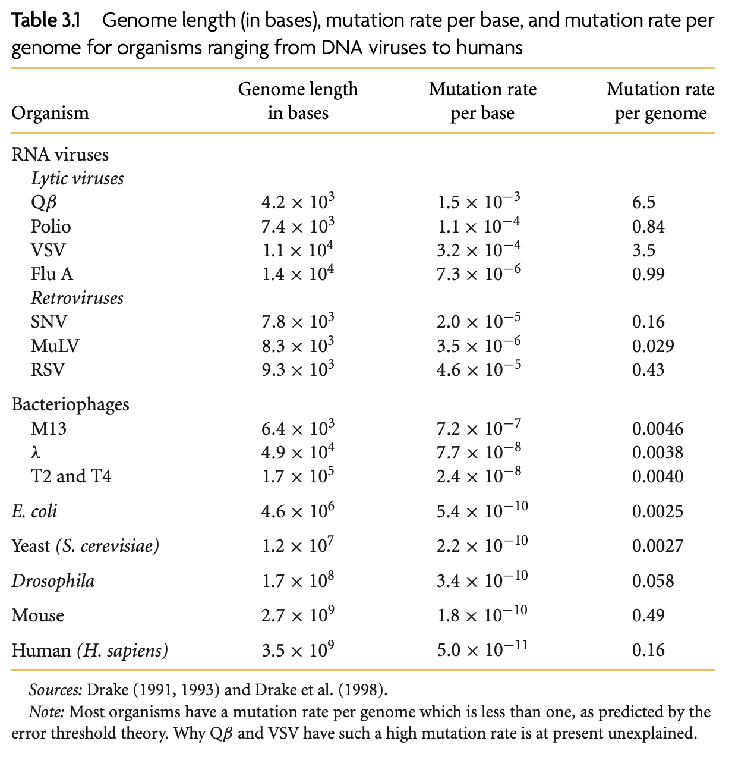
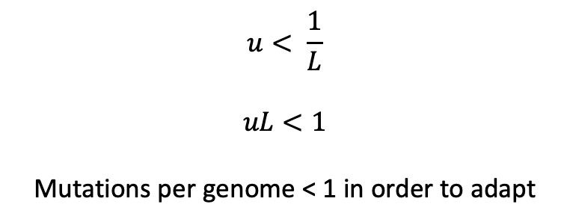
Mutation rates and adaptation
$$u< \frac{1}{L}$$
$$uL<1$$
Mutations per genome < 1 in order to adapt
Nowak, Evolutionary Dynamics

